Slide 1
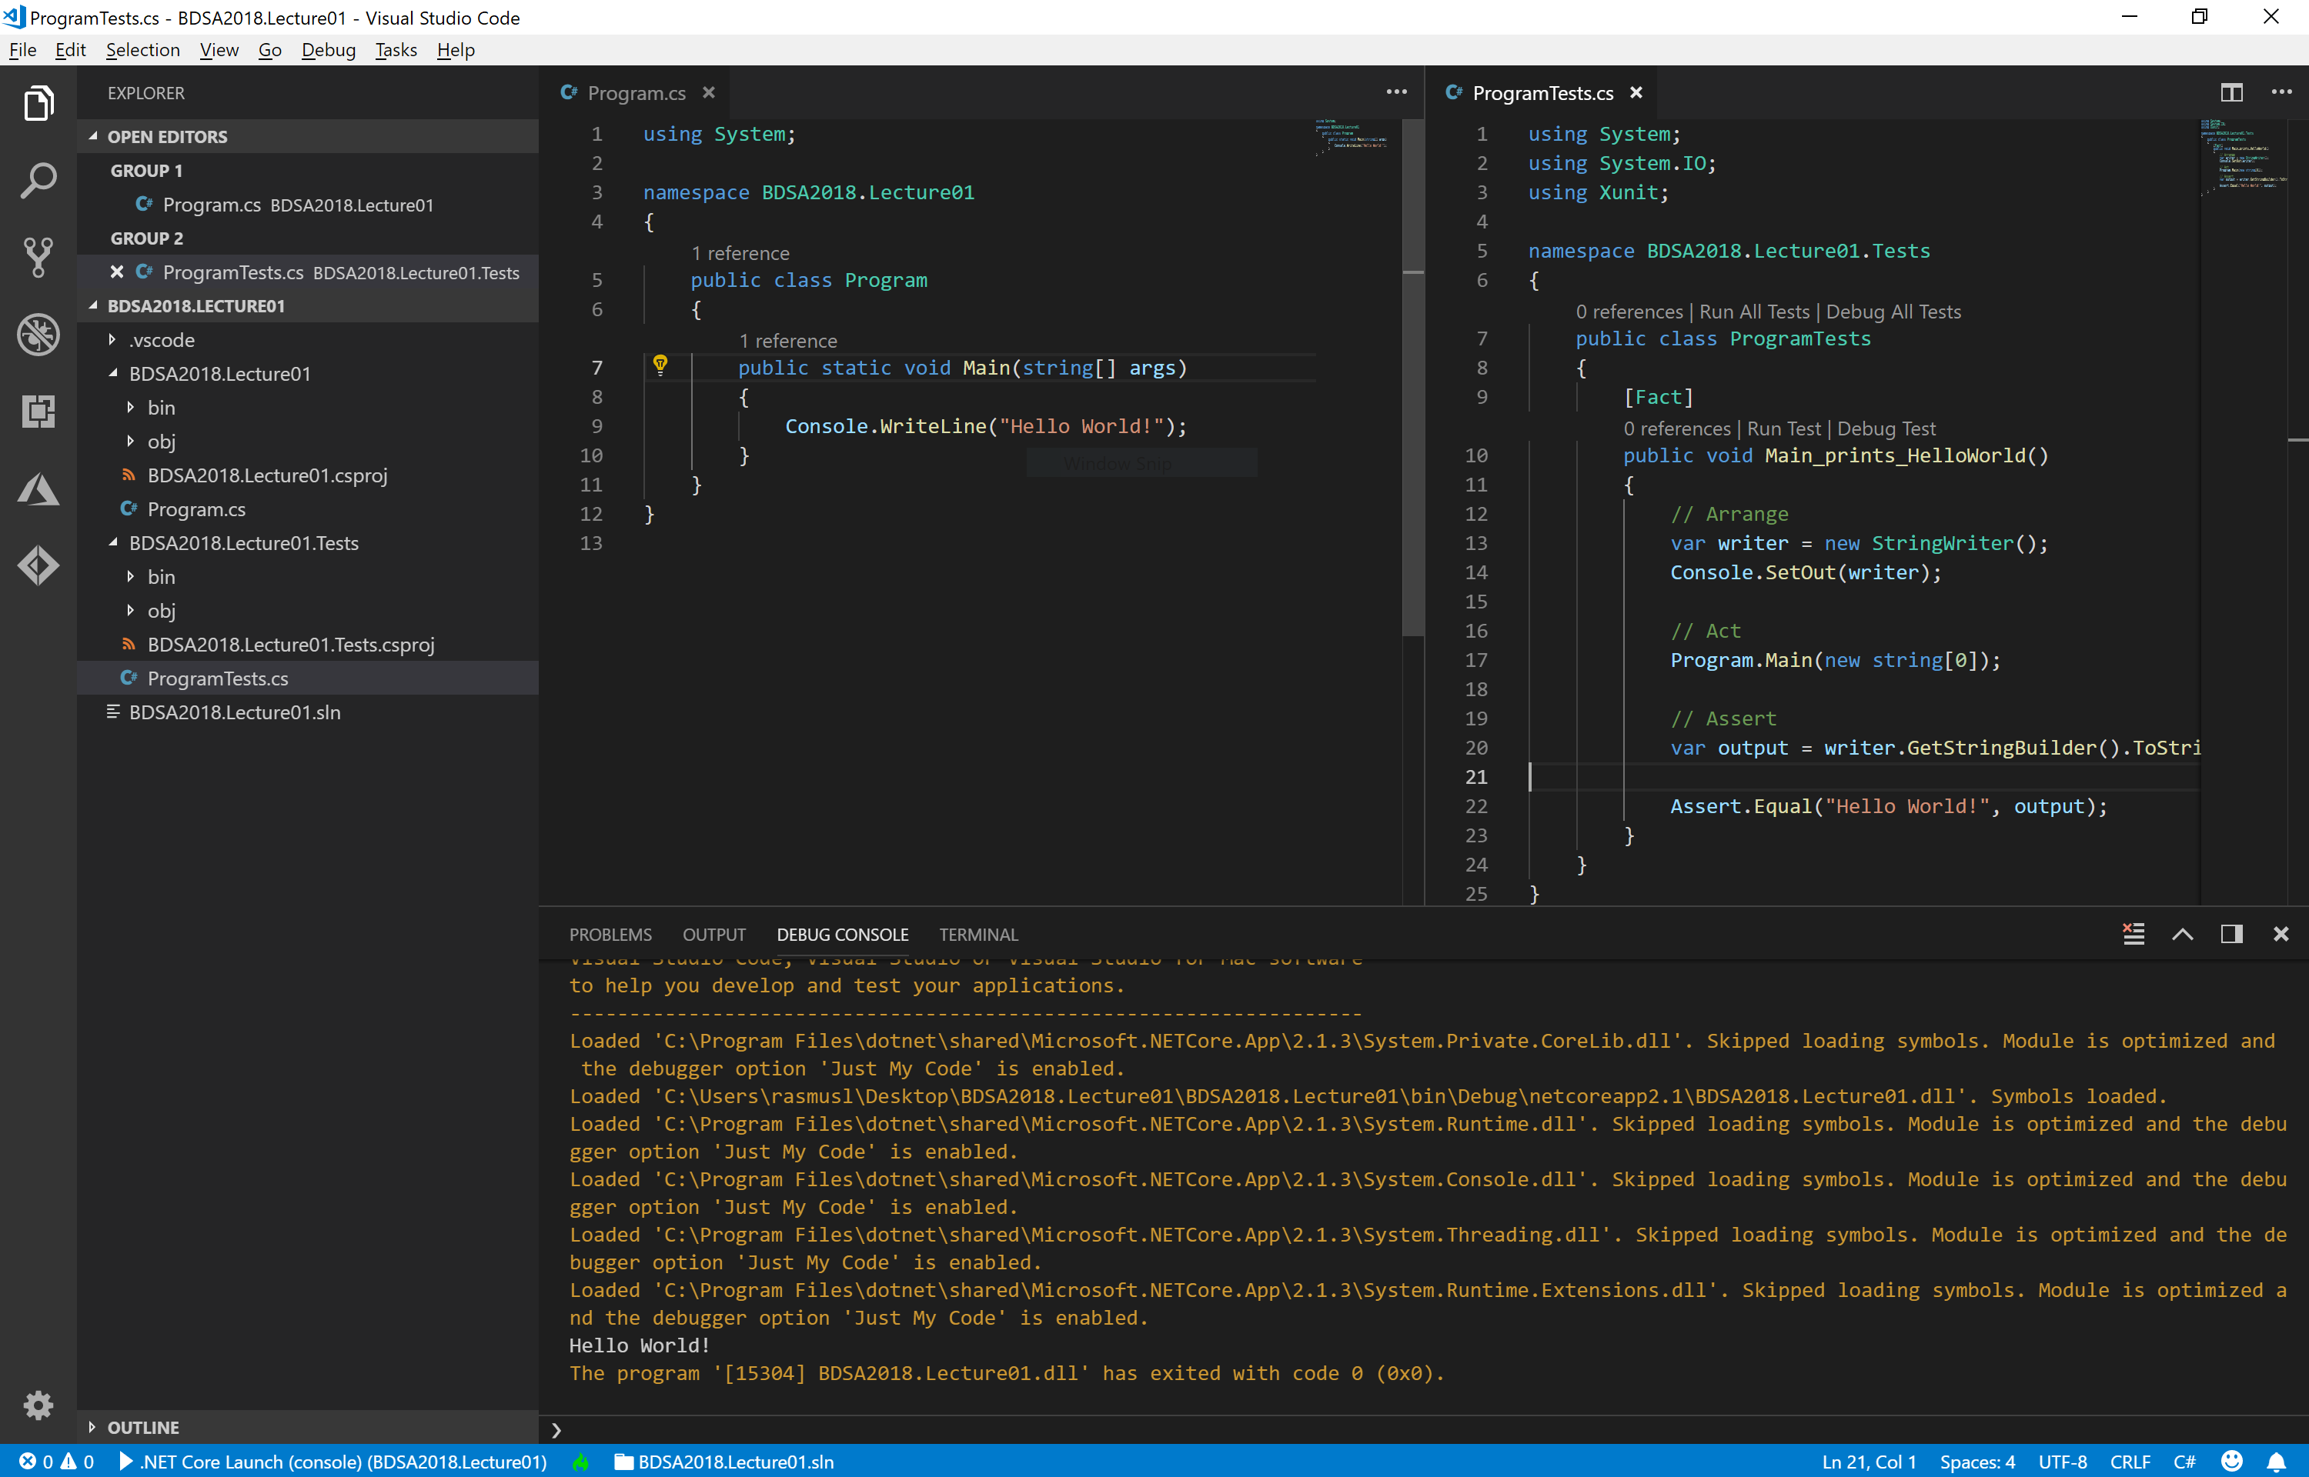
Test Driven C♯
Rasmus Lystrøm
Associate Professor
ITU
rnie@itu.dk

Slide 2







Me
M.Sc. IT, ITU Thesis: Forecalc – Developing a core spreadsheet implementation in F♯
Senior Consultant @ Microsoft DevOps, Cloud, Security
Hobbies
Associate Professor @ ITU Object-Oriented Programming, C♯, F♯, .NET Core
Captain @ Danish Army (Reserve) Acting Battalion Chief of Staff, Battalion Chief Operations Officer
Wife: Katrine, Children: Lærke (1), Laura (4) and Alma (11) Origin: Aarhus, Current whereabouts: Vanløse, Copenhagen

Slide 3
Agenda
Exercises
Why C♯
Curriculum
TDD
.NET (Core)
C♯
Visual Studio Code
Visual Studio 2019

Slide 4
Exercises
Correction:
Exercise01 will count towards 8 of 10
Submission (individual)
Technical setup (VSCode, fork, git)
Group members

Slide 5
Why C♯
Stack Overflow Annual Developer Survey 2019 – 90,000 respondents
Popularity (professional developers):
C♯: 31.9%
ASP.NET: 27.2%
.NET: 38.1%
.NET Core: 24.5%
Microsoft SQL Server: 34.4%
Visual Studio Code: 34.9% (top 1)
Source: https://insights.stackoverflow.com/survey/2019

Slide 6
Why C♯
Love:
C♯: 67.0%
ASP.NET: 64.9%
.NET: 61.0%
.NET Core: 77.2%
Microsoft SQL Server: 57.5%
% of developers who are developing with the language or technology and have expressed interest in continuing to develop with it
Source: https://insights.stackoverflow.com/survey/2019

Slide 7
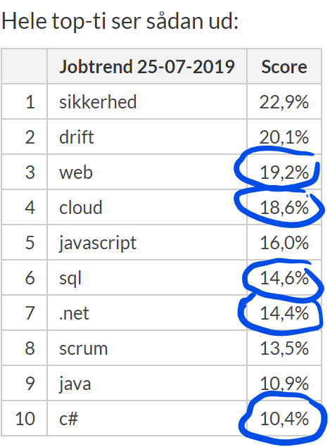
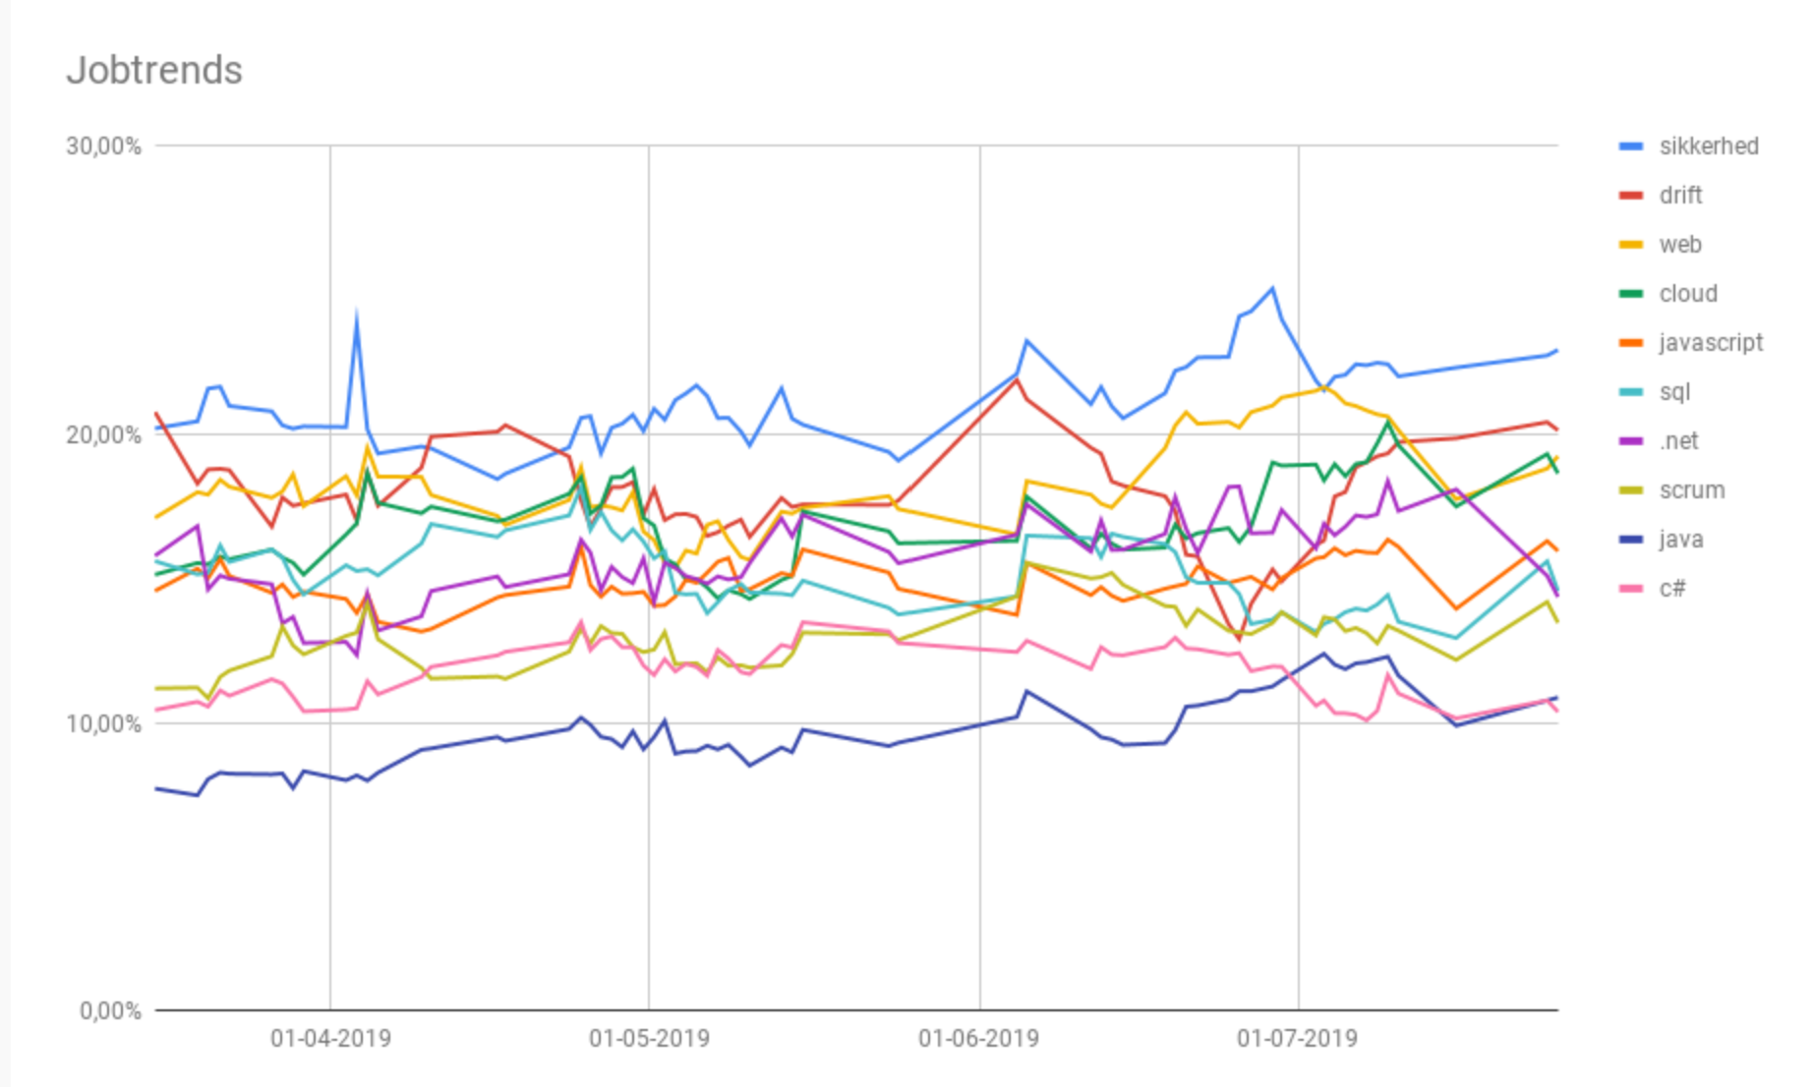
Job trends
Source: https://www.version2.dk/artikel/jobtrends-java-slaar-c-paa-maalfoto-1088564

Slide 8
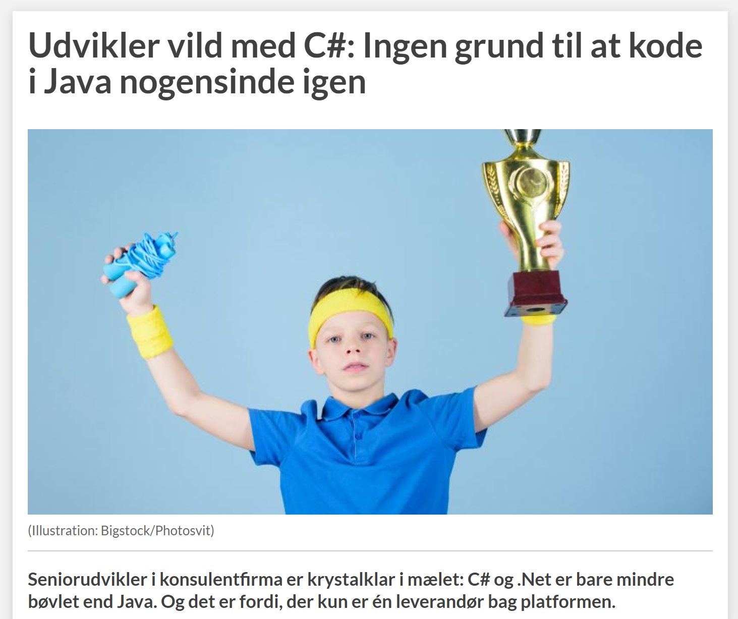

Source:
https://www.version2.dk/artikel/udvikler-vild-med-c-ingen-grund-at-kode-java-nogensinde-igen-1088651

Slide 9
Curriculum
C♯ - Test Driven Development
Generics
Lambdas and Linq
Data access (SQL + Entity Framework)
Asynchronous and parallel processing
ASP.NET Core Web API
Design Patterns in Practice
Mobile apps with UWP and Xamarin.Forms
Security
Cloud

Slide 10
Test-Driven Development
What?
Why?
How?

Slide 11
RED-GREEN-REFACTOR
How?
[Start]
Add a test
[No]
[Pass]
Run the tests
Done?
[Fail]
[Yes]
Refactor
[End]

Slide 12

A brief introduction

Slide 13
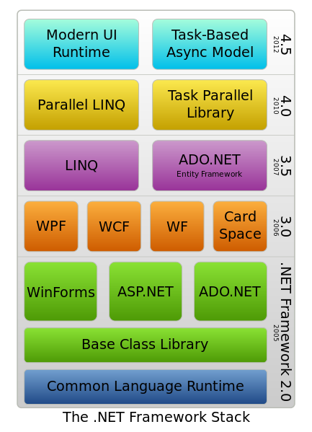
.NET Framework
Versions
1.0 Visual Studio .NET (2002)
1.1 Visual Studio .NET 2003
2.0 Visual Studio 2005
3.0 (2006)
3.5 Visual Studio 2008 (2007)
4.0 Visual Studio 2010
4.5 Visual Studio 2012
4.5.1 Visual Studio 2013
4.6 Visual Studio 2015
4.7 Visual Studio 2017
4.8 Visual Studio 2019
.NET Core 1.0 (2016)
.NET Core 2.0 (2017)
.NET Core 3.0 (2019) (planned)
.NET 5 (2020) (planned)

Slide 14
C♯
Show me the CODE!!!
C♯ is intended to be a simple, modern, general-purpose, object-oriented programming language.
Ecma International (2006)

Slide 15
mkdir BDSA2019.Lecture01
cd BDSA2019.Lecture01
mkdir BDSA2019.Lecture01
mkdir BDSA2019.Lecture01.Tests
cd BDSA2019.Lecture01
dotnet new console
cd ..
cd BDSA2019.Lecture01.Tests
dotnet new xunit
dotnet new sln
dotnet sln add BDSA2019.Lecture01
dotnet sln add BDSA2019.Lecture01.Tests
dotnet add reference ..\BDSA2019.Lecture01
cd ..
code .

Slide 16
C♯
Language Basics

Slide 17
Naming Conventions
Composed names
currentLayout, CurrentLayout
Variables and fields
vehicle, leftElement
Private fields
_vehicle, _leftElement
Methods
CurrentVehicle(), Size()
Properties
Pi, Name, Size
Classes
MyClass, List<T>
Interfaces
IException, IObserver
https://docs.microsoft.com/en-us/dotnet/standard/design-guidelines/naming-guidelines

Slide 18
Value Types can never be null!
Value Types
Holds a value – assignment copies the value
Struct
Numeric types
Integral types
Floating point types
Decimal
bool
Enumeration
User defined structs
Integral
byte, sbyte,
short, ushort,
Char,
int, uint,
long, ulong
Floating point
float
Double
Decimal
decimal
enum Days {Sat, Sun, Mon, Tue, Wed, Thu, Fri};
System.Guid
System.Drawing.Point
System.DateTime
System.Numerics.BigInteger
System.Numerics.Complex

Slide 19
Value Types
int age;
System.Int32 age;
Int32
+MaxValue
+MinValue
System.Object
+Equals()
+ComparesTo()
+ToString()
+GetHashCode()
+GetType()
+Parse()
+TryParse()
…
System.ValueType

Slide 20
Value Types
Memory
int i1 = 42;
i1: int
i2: int
int i2 = i2;
ReferenceEquals is always false

Slide 21
Reference Types
Memory
var car = new Vehicle();
Vehicle: object
Vehicle audi = null;
audi = car;

Slide 22
Reference Type Equality
ReferenceEquality:
Person p1 = new Person(“Joe”);
Person p2 = new Person(“Joe”);
Person p3 = p2;
ReferenceEquality(p1, p2) = false
ReferenceEquality(p2, p3) = true;
In C# the == operator is “equal” to reference equality. (Can be overridden)
Value Equality (for reference types)
p1.Equals(p2) = true; (Can be overridden)

Slide 23
Value Type Equality
Equals the same as for reference types
object.ReferenceEquality will always return false for value types
== operator is overridden so it does value equality

Slide 24
String Interning
string a = "Peter";
string b = "Peter";
a.Equals(b); ==> true
a == b; ==> true
object.ReferenceEquals(a, b); ==> true
String Interning
The String Type is Immutable – assigning creates a new value…

Slide 25
Local Variable Type Inference
var identifier = expression;
var is a keyword, not a type

Slide 26
Enumeration
public enum Day { Mon, Tue, Wed, Thu, Fri, Sat, Sun }
public enum Month : uint { Jan = 1, Feb, Mar, }
public enum Color : uint { Red = 0xFF0000,
Green = 0x00FF00,
Blue = 0x0000FF }
Vehicle car = new Vehicle();
car.Color = Color.Red;
Console.Write(Day.Mon);

Slide 27
Array stuff
int[] intArray = new int[4];
double[,] doubleArray = new double[4, 5];
int[,] array1 = {{1,2],{3,4]};
int value1 = intArray[0];
double value2 = doubleArray[0,1];
Console.WriteLine(array1[1,1]);
Arrays are 0-based

Slide 28
String stuff
public static void Main(string[] args)
{
var name = "Anders";
var argument = args[0];
Console.WriteLine(10 + " hello " + name + argument);
Console.WriteLine("Hello {0}", name);
Console.WriteLine($"Hello {name}");
}
Automatic conversion
String Format
String Interpolation (preferred)

Slide 29
Compile, test, and run from the Command Line
$ dotnet build
$ dotnet test
$ dotnet run

